Slide 1
Data Structures and Algorithms
CACS201
Unit 1: Introduction to Data Structure
Shyam Sunder Khatiwada

Slide 2
Data Types
A data type, in programming, is a classification that specifies which type of value a variable has and what type of mathematical, relational or logical operations can be applied to it without causing an error.
A string, for example, is a data type that is used to classify text and an integer is a data type that is used to classify whole numbers.
For example,
c supports char, int, float, long etc.
Python supports String, List, Tuple, etc.

Slide 3
Data Types
Primitive: Basic building blocks (Boolean, integer, float, char etc.)
Composite: Any data type ( struct, array, String etc.) composed of primitive data types.
Abstract : Data type that is defined by its behaviour (tuple, set, stack, queue, graph etc.)

Slide 4
Data Types
In a broad sense, there are three types of data types:
Fundamental (Built-in) data types
These are the predefined data types which are used by the programmer directly to store only one value as per requirement, i.e., integer type, character type, or floating type.
Derived data types
These data types are derived using built-in data type which are designed by the programmer to store multiple values of same type as per their requirement.
For example - Array, Pointer, list, etc.
User-defined data types
These data types are derived using built-in data types which are wrapped into a single a data type to store multiple values of either same type or different type or both as per the requirement.
For example- Class, Structure, etc.

Slide 5
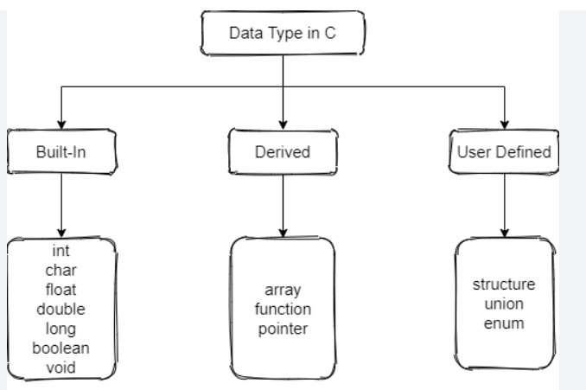
Data Types

Slide 6
Data Structure
Data structure is a way of organizing all data items and establishing relationship among those data items.
Data structure are the building blocks of a program.
Data structure mainly specifies the following four things:
Organization of data
Accessing methods
Degree of associativity
Processing alternatives for information

Slide 7
Data Structure
To develop a program of an algorithm, we should select an appropriate data structure for that algorithm.
Therefore algorithm and its associated data structures from a program.
Algorithm + Data Structure = Program
A static data structure is one whose capacity is fixed at creation. For example, array.
A dynamic data structure is one whose capacity is variable, so it can expand or contract at any time. For example, linked list, binary tree etc.

Slide 8
Data Structure
Depending on your requirements and project, it is important to choose the right data structure for your project.
For example, if you want to store data sequentially in the memory, then you can go for the Array data structure.
A data structure should be seen as a logical concept that must address four fundamental concerns.
how the data will be stored
what operations will be performed on it
how are the data associated
how can they be accessed

Slide 9
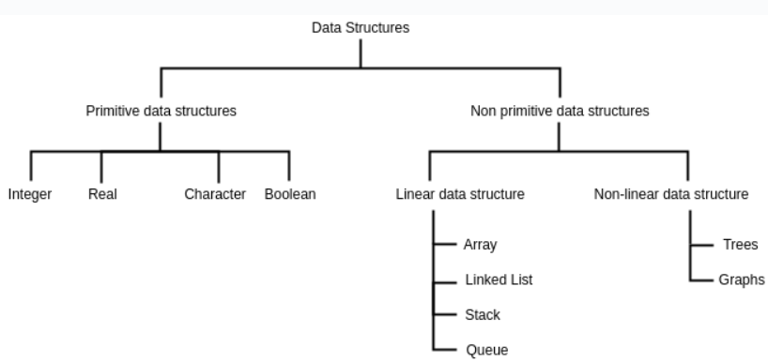
Types of Data Structure

Slide 10
Types of Data Structure
There are two types of data structures:
Primitive data structures
Non-primitive data structures
Primitive data structures
The primitive data structures are primitive data types. The int, char, float, double and pointer are the primitive data structures that can hold a single value.
Non primitive data structures
The data structures that is constructed with the help of any one of the primitive data structures and it is having a specific functionality. It can be user-defined. It can be classified as:
Linear data structure
Non-linear data structure

Slide 11
Linear Data Structure
In Linear data structures, the elements are arranged in sequence one after the other.
Since elements are arranged in particular order, they are easy to implement.
Some of linear data structures are:
Array data structure
Stack data structure
Queue data structure
Linked List data structure

Slide 12
Non Linear Data Structure
Unlike linear data structures, elements in non-linear data structures are not in any sequence.
Instead they are arranged in a hierarchical manner where one element will be connected to one or more elements.
For example graph and tree-based data structures

Slide 13
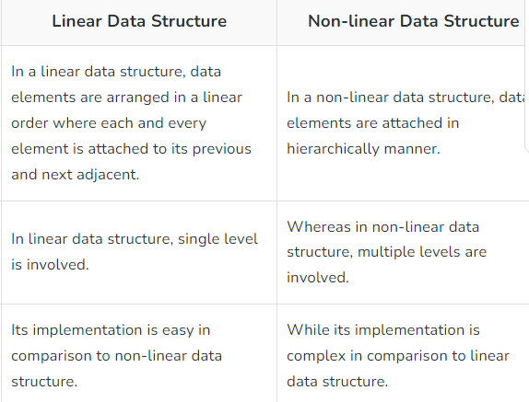
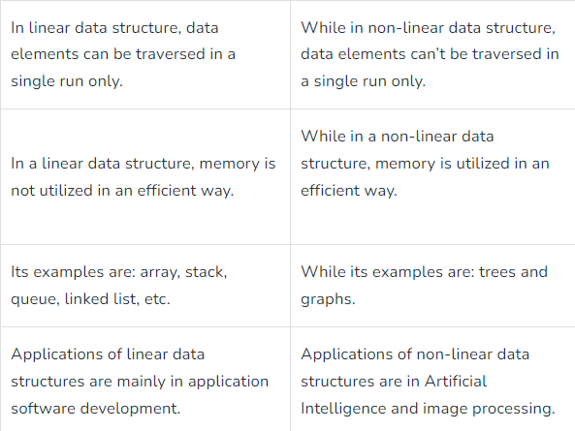
Linear vs Non Linear Data Structure

Slide 14
Major Operations in Data Structures
Searching: can search for any element in data structure
Sorting: can sort the elements of a data structure either in a ascending or descending order.
Insertion: can also insert the new element in a data structure
Updation- can also update the element, i.e., we can replace the elements with another element.
Deletion: can remove the element from the data structure

Slide 15
Advantage of Data Structures
The following are the advantages of a data structure:
Efficiency: If the choice of a data structure for implementing a particular ADT is proper, it makes the program very efficient in terms of time and space.
Reusability: The data structure provides reusability means that multiple client program can use the same data structure.
Abstraction: The data structure specified by an ADT also provides the level of abstraction. The client cannot see the internal working of the data structure, so it does not have to worry about the implementation part.Only can see the interface.

Slide 16
Abstract Data Type
Defines what it does and ignores how it does its job
An abstract data type is an abstraction of a data structure that provides only the interface to which the data structure must adhere.
The interface does not give any specific details about something should be implemented by using any one programming language.
In other words, ADT are the entities that are definitions of data and operations but do not have implementation details.

Slide 17
Abstract Data Type
We know the data that we are storing and the operations that can be performed on the data, but we don’t know about the implementation details.
The reason for not having implementation details is that every programming language has a different implementation strategy for example-
a C data structure is implemented using structures while a c++ data structure is implemented using objects and classes.

Slide 18
Abstract Data Type
The fundamentals of how the data is stored should be invisible to the user.
Integers are an ADT,
defined as the values ……, -2,-1,0,1,2,...... and
by the operations of addition, subtraction, multiplication, and division etc.,
Some examples of ADT are Stack, Queue, List etc.

Slide 19
Dynamic Memory Allocation in C
An array is a collection of a fixed number of values. Once the size of an array is declared, you cannot change it.
Sometimes the size of the array you declared may be insufficient.
To solve this issue, you can allocate memory manually during run-time. This is known as dynamic memory allocation.
To allocate memory dynamically, library functions are:
malloc(), calloc(), realloc(), free()
These functions are defined in the <stdlib.h> header file.

Slide 20
malloc()
The name “malloc” stands for memory allocation.
The malloc() function reserves a block of memory of the specified number of bytes.
It returns a pointer of void which can be casted into pointers of any form.
syntax:
ptr=(castType*)malloc(size)
Example
ptr=(float*)malloc(100*sizeof(float));
it will allocates 400 bytes of memory. It’s because the size of float is 4 bytes.
The expressions results in a NULL pointer if the memory cannot be allocated.

Slide 21
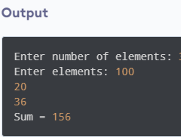
Source Code: malloc()
// Program to calculate the sum of n numbers entered by the user
#include <stdio.h>
#include <stdlib.h>
int main() {
int n, i, *ptr, sum = 0;
printf("Enter number of elements: ");
scanf("%d", &n);
ptr = (int*) malloc(n * sizeof(int));
// if memory cannot be allocated
if(ptr == NULL) {
printf("Error! memory not allocated.");
exit(0);
}
printf("Enter elements: ");
for(i = 0; i < n; ++i) {
scanf("%d", ptr + i);
sum += *(ptr + i);
}
printf("Sum = %d", sum);
// deallocating the memory
free(ptr);
return 0;
}

Slide 22
calloc()
The name “calloc” stands for contiguous allocation.
The malloc() function allocates the memory and leaves the memory uninitialized, whereas the calloc() function allocates memory and initialize the all bits to zero.
syntax:
ptr=(castType*) calloc(n,size);
Example:
ptr=(float*)calloc(25, sizeof(float));
The above statement allocates contiguous space in memory for 25 elements of type float.

Slide 23
free()
Dynamically allocated memory created with either calloc() or malloc() doesn’t get freed on their own.
You must explicitly use free() to release the space.
Syntax:
free(ptr);
This statement frees the space allocated in the memory pointed by ptr.

Slide 24
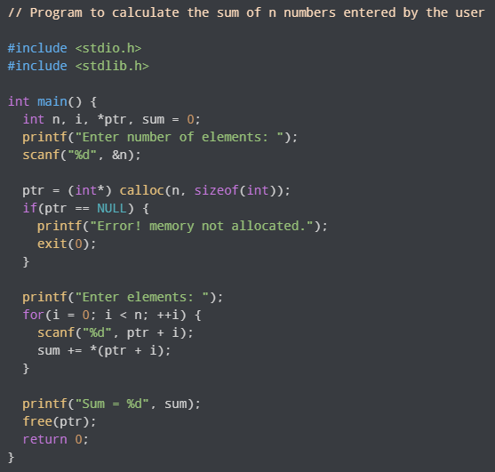
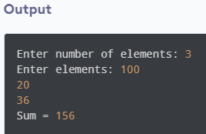
Source Code: calloc() and free()

Slide 25
realloc()
If the dynamically allocated memory is insufficient or more than required, you can change the size of previously allocated memory using the realloc() function.
To increase or decrease the memory allocated by malloc() or calloc()
Syntax:
ptr=realloc(ptr,x);
Here, ptr is reallocated with a new size x.

Slide 26
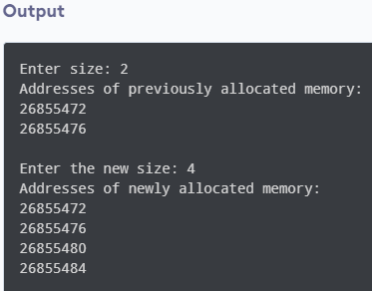
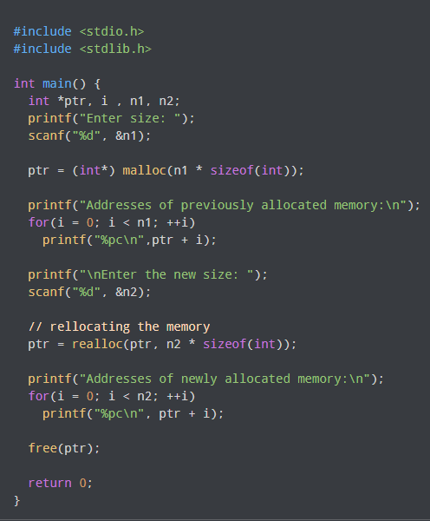
Source Code: realloc()

Slide 27
Any Query??
~Thank You~
Prepared by:Shyam Sunder Khatiwada

